Slide 1
Cloud Computing

Slide 2
What is Cloud computing?
Cloud computing is the on-demand availability of computer system resources, especially data storage and computing power, without direct active management by the user. Large clouds often have functions distributed over multiple locations, each location being a data center.

Slide 3
What is data centre?
Desktop
Laptop
Work station
Racks
Data centres
Blade Servers

Slide 4
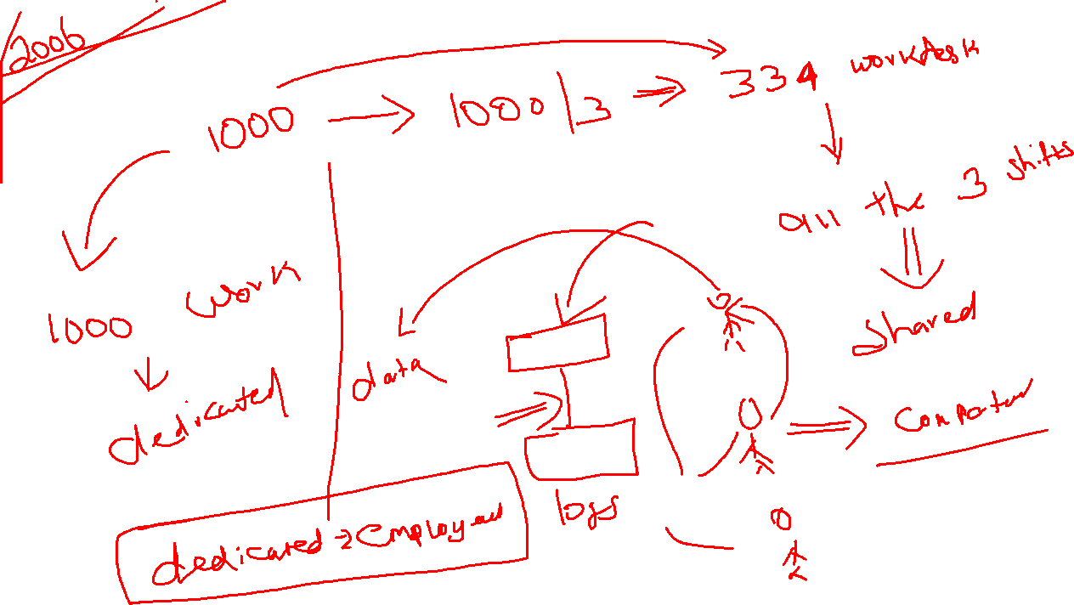

Slide 5
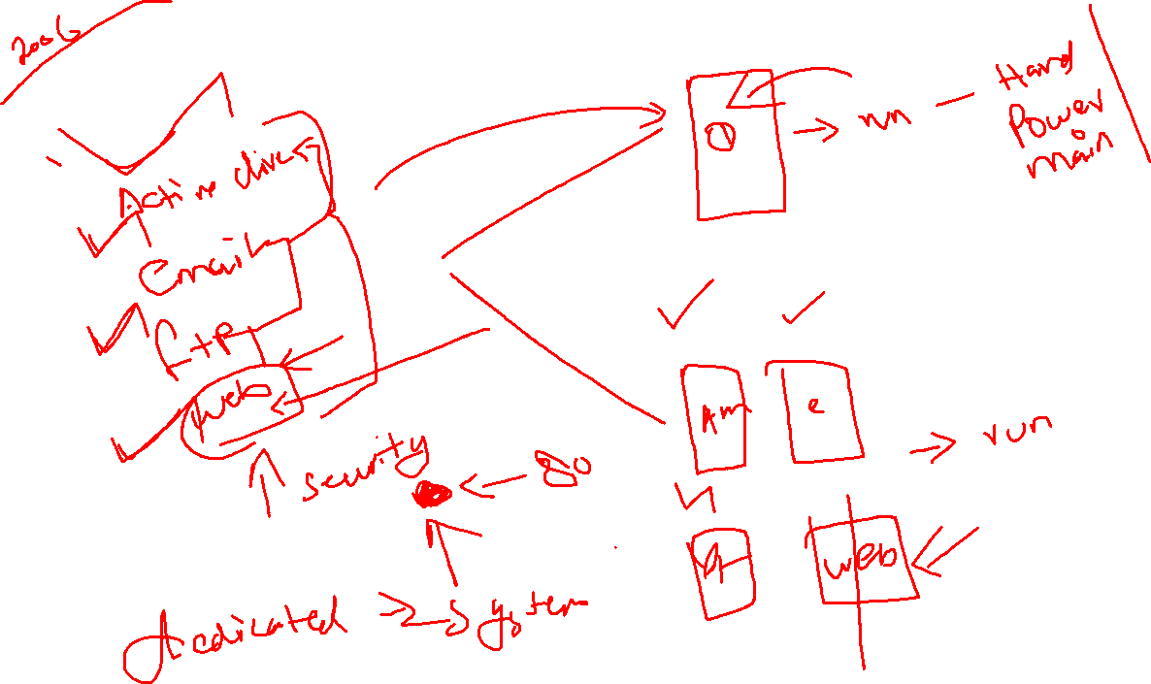

Slide 6
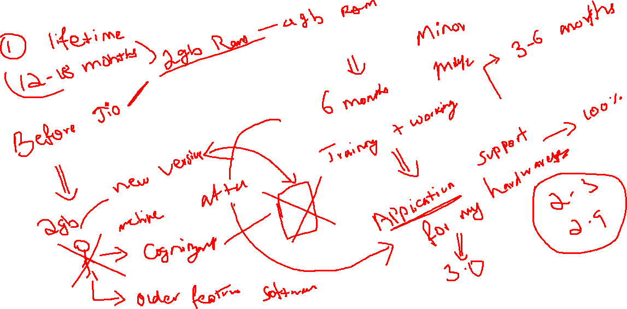
Dedicated – Users – Application -> System

Slide 7
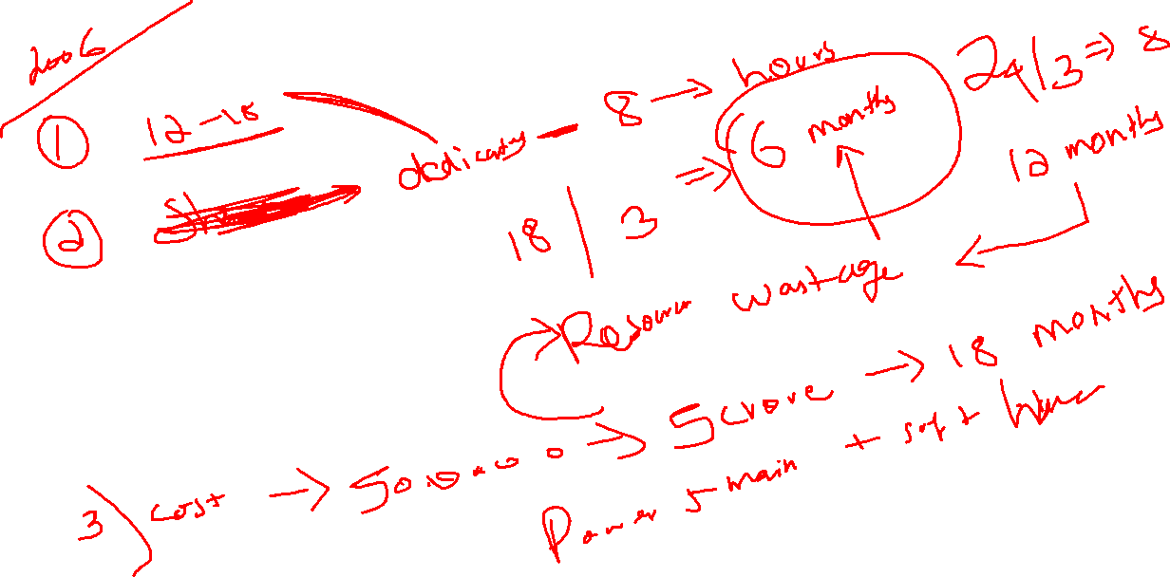

Slide 8
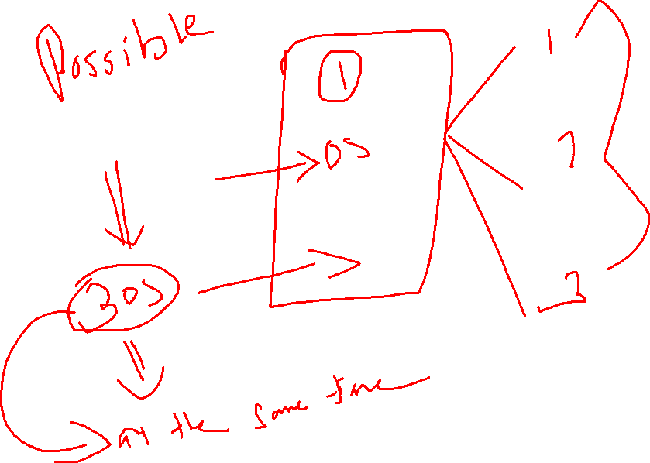

Slide 9
Why we cant install multiple OS on the same hardware and able to work on all those OS at the same time?

Slide 10
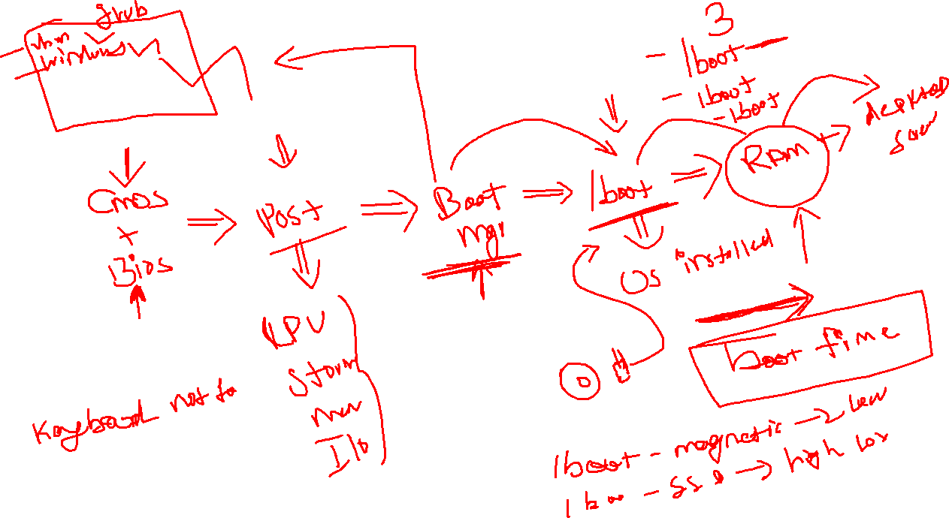
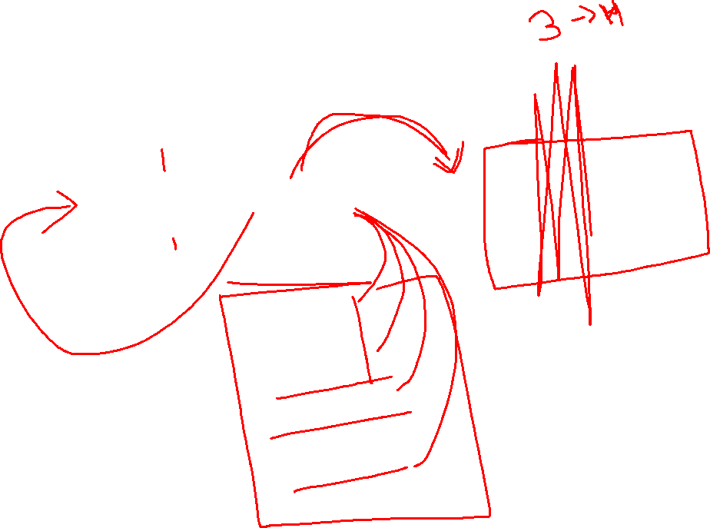

Slide 11
Cloud is the concept that is evolved from the base technology called hypervisor
Hypervisor -> that will create the software based environment to boot the multiple OS at the same time – 2006-2008

Slide 13
What is Hypervisors?
How it will work?
Types of Hypervisors?
Advantages of Hypervisors?
Disadvantage of Hypervisors?
How Cloud is evolved from hypervisors?

Slide 14
What is Hypervisor?
A hypervisor is a kind of emulator; it is computer software, firmware or hardware that creates and runs virtual machines.
A computer on which a hypervisor runs one or more virtual machines is called a host machine, and each virtual machine is called a guest machine.

Slide 15
How it will work?
Hypervisor – software defined environment that the OS will trust that software defined environment as real environment and run its architecture

Slide 16
Types of Hypervisors
2 types
Type 1
Type 2

Slide 17
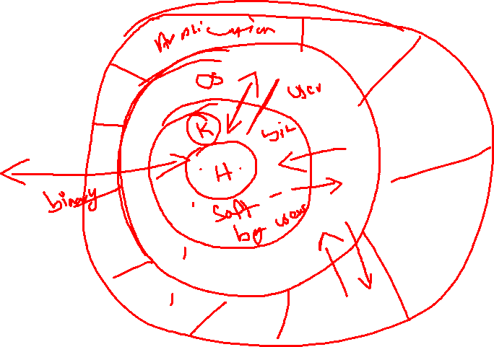

Slide 18
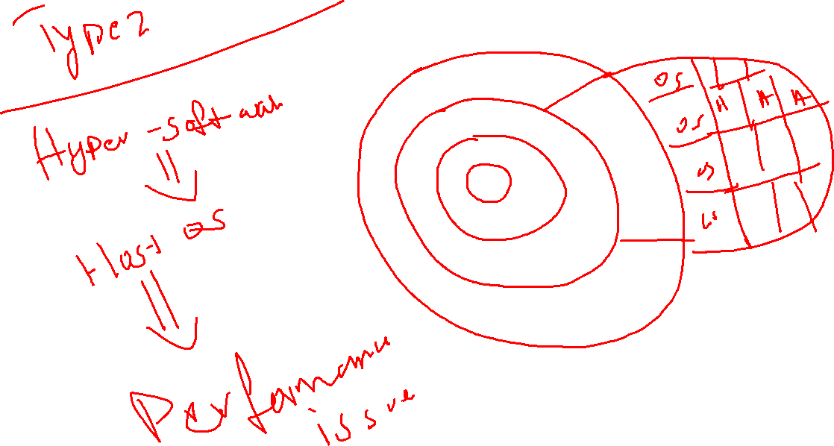

Slide 19
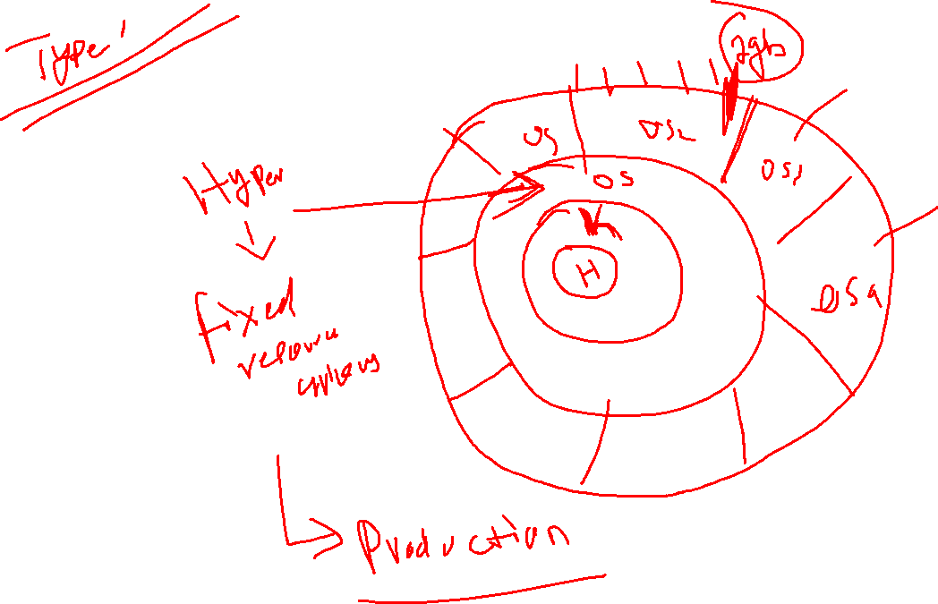

Slide 20
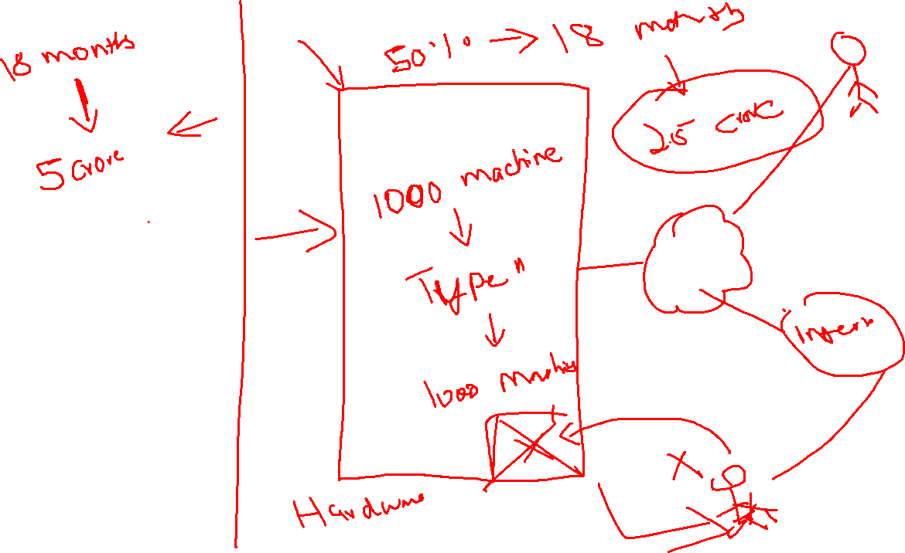

Slide 21
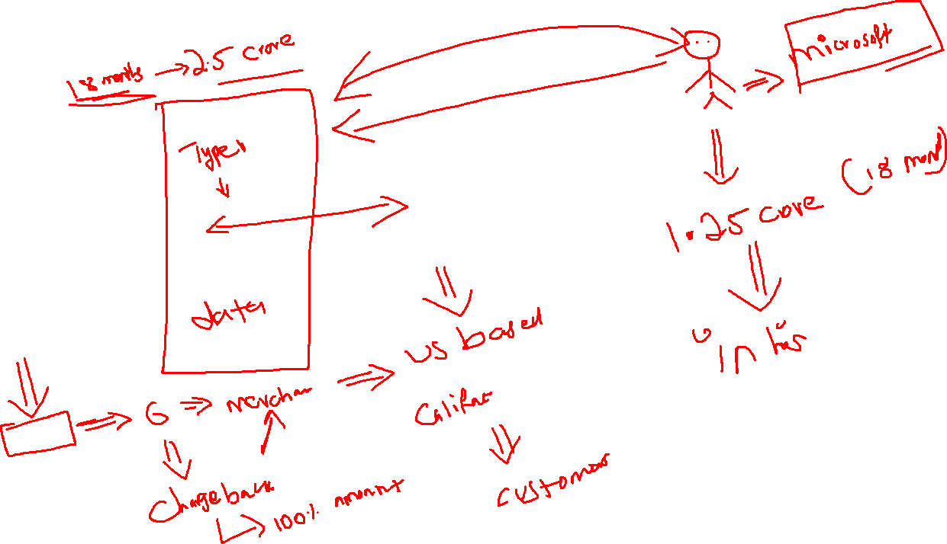

Slide 22
Types of cloud
Public
Private
Hybrid
Community

Slide 23
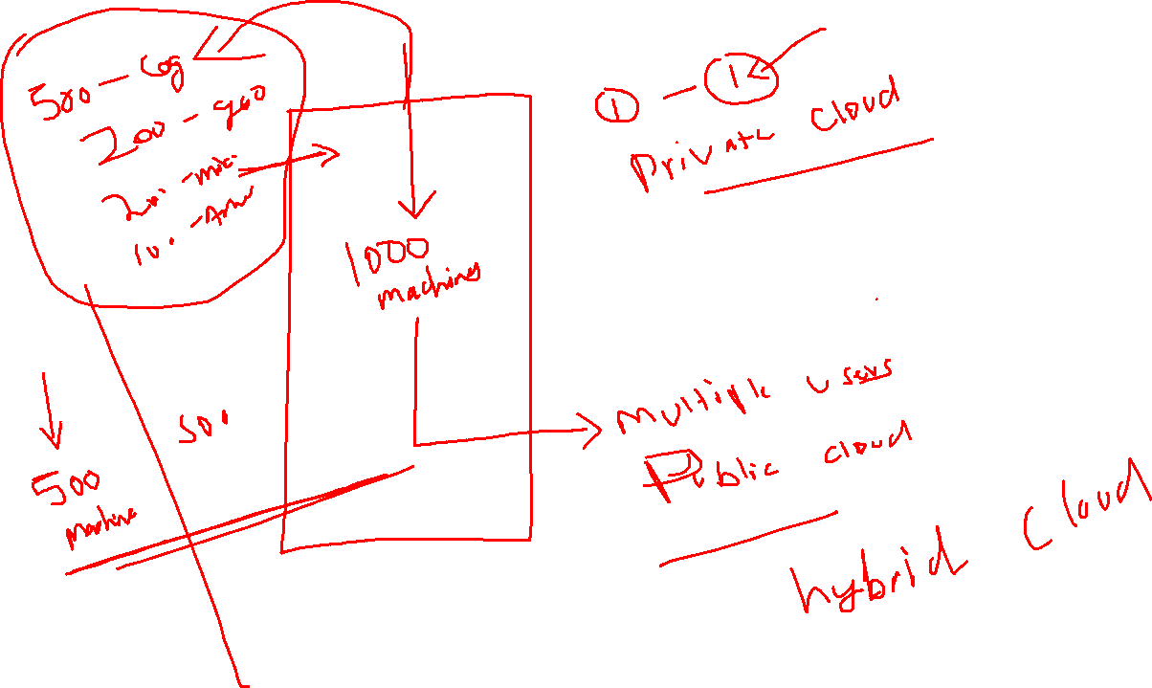

Slide 24
Categories of Cloud
IAAS
SAAS
PAAS

Slide 25
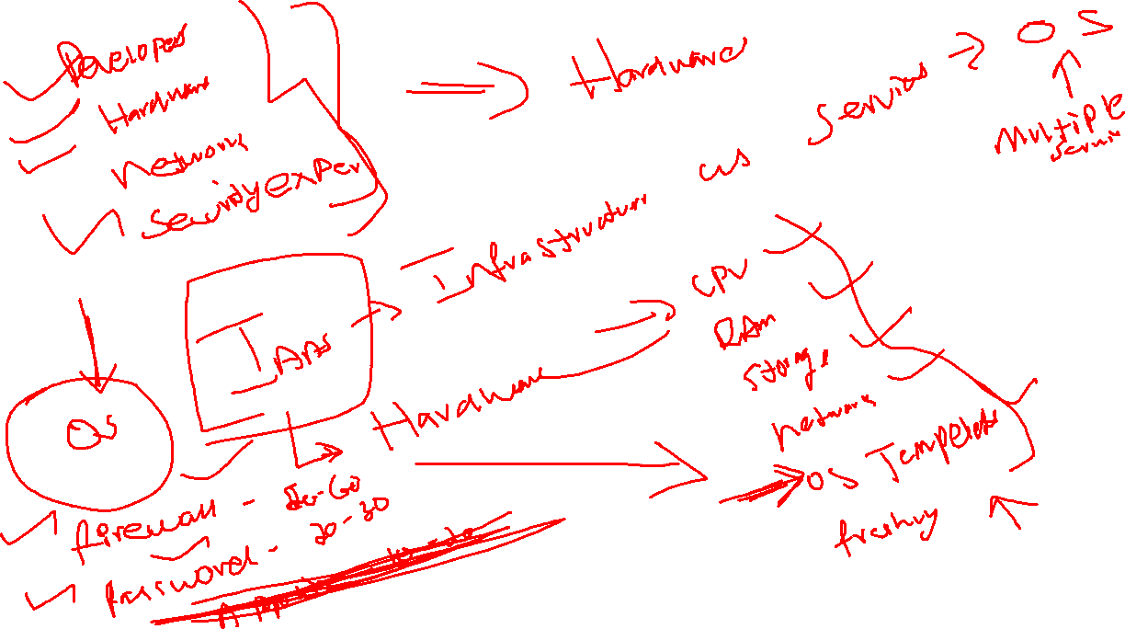

Slide 26
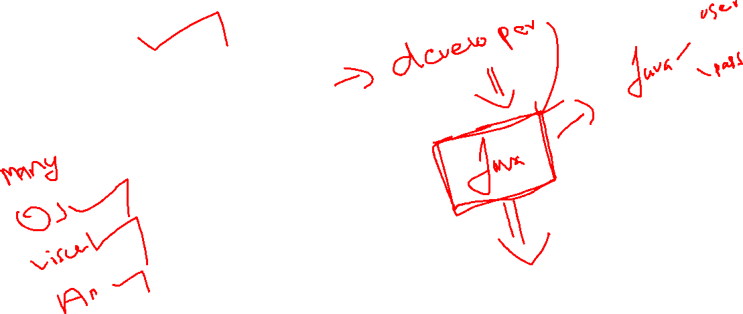
SAAS -> Software as service

Slide 27
PAAS

Slide 28
eLearning
https://www.youtube.com/watch?v=usYySG1nbfI&t=166s

